Slide 1

Web Project for Exchange Student
SKKUEXS
김주원 | 서현원 | 이하은 | 한희근

Slide 2


Natural Language Processing using Deep Learning
Tokenization
Embedding
MLP
RNN
Seq2Seq
Attention
Transformer
GPT

Slide 3

Tokenization
Dividing a sentence into small units called tokens
Token?
Smallest unit that make up a sentence,
usually consisting of words, punctuation marks, and other elements.
3

Slide 4
Tokenization
Dividing a sentence into small units called tokens
I like to eat apples
I like to eat apples
4

Slide 5

Embedding
Converting words or text into a numerical format
Apple = [0.2, -0.5, 0.4 ]
Banana = [-0.1, 0.3, 0.2 ]
Word2Vec
5

Slide 6
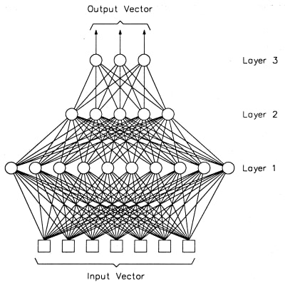
MLP
Multi-Layer Perceptron
Artificial neural network
composed of
multiple layers of neurons
6

Slide 7
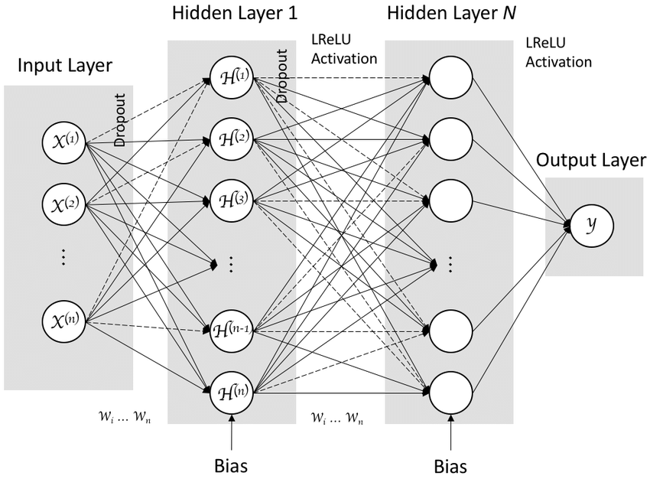
MLP
Multi-Layer Perceptron
Non-linearity into the network
ReLU, sigmoid, tanh
Learned during the training process
7

Slide 8
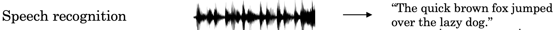
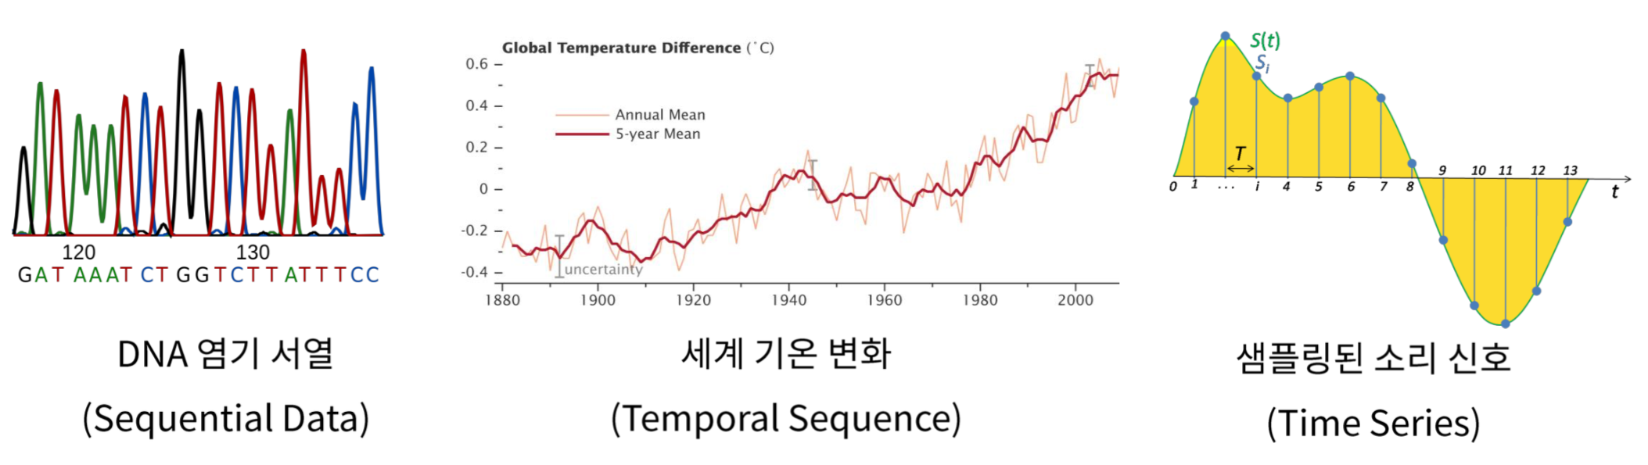
RNN
Recurrent Neural Network
DNA Nucleic Sequence
Temperature Difference
Sampled Sound Signal
8

Slide 9
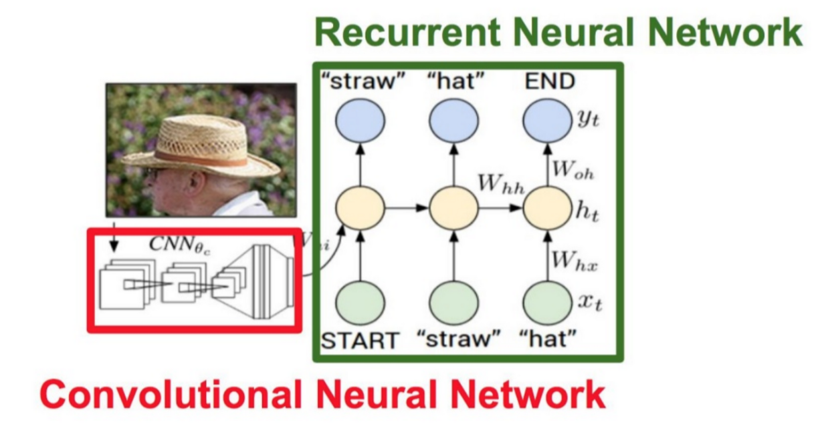
RNN
Recurrent Neural Network
9

Slide 10
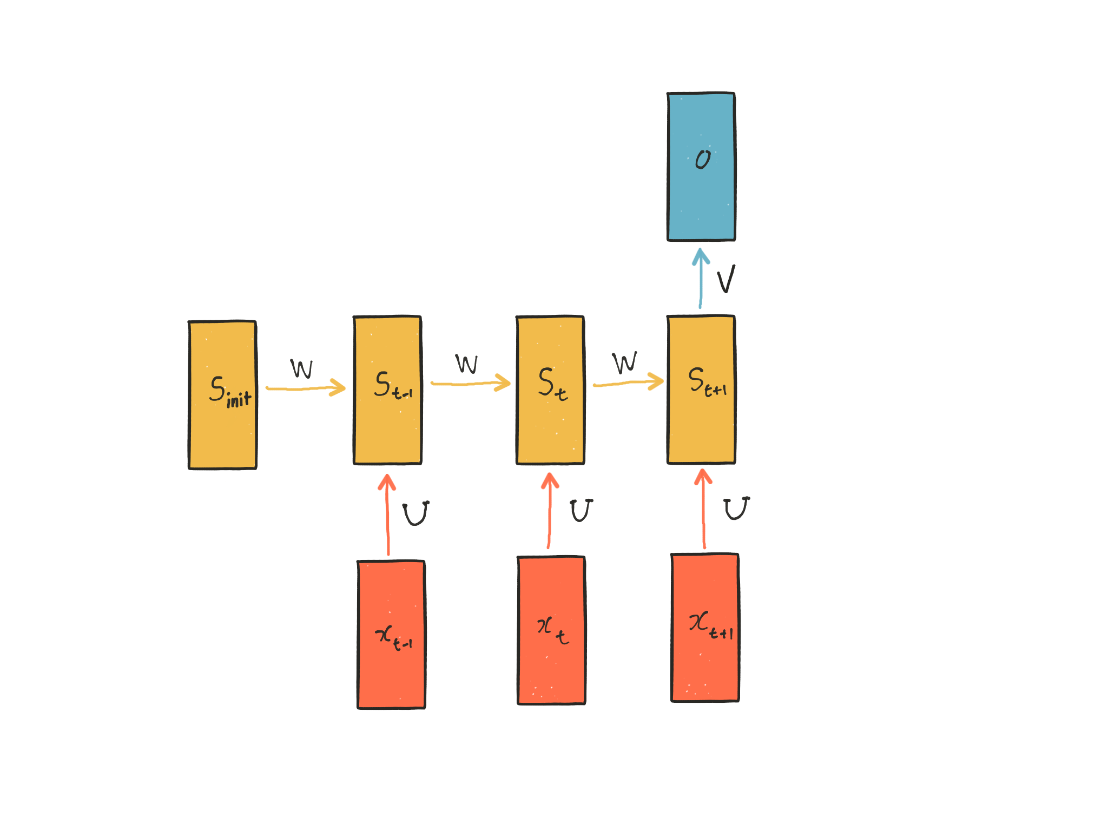
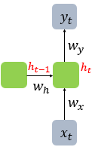
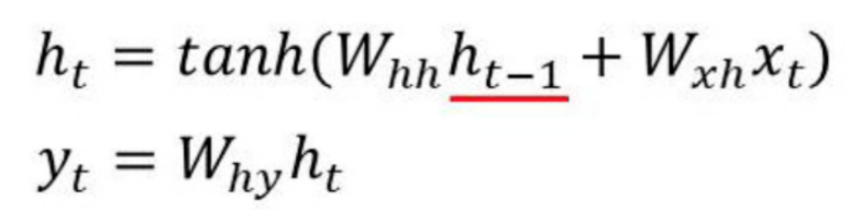
RNN
Recurrent Neural Network
Previous hidden state
10

Slide 11
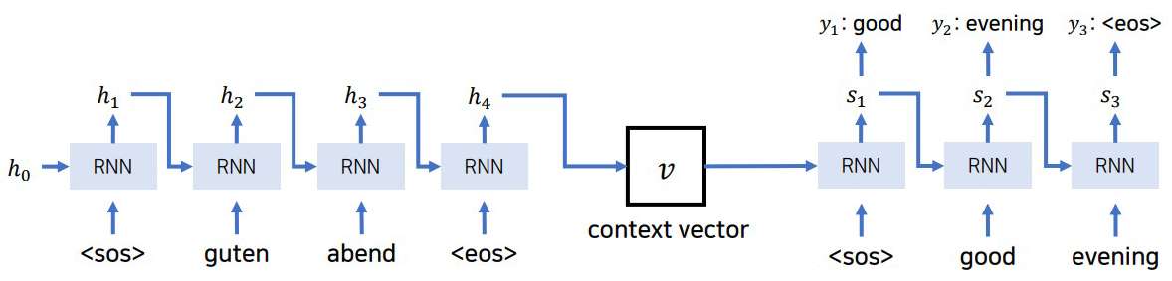
Seq2Seq
make one sequence to another sequence
encoder
decoder
11

Slide 12
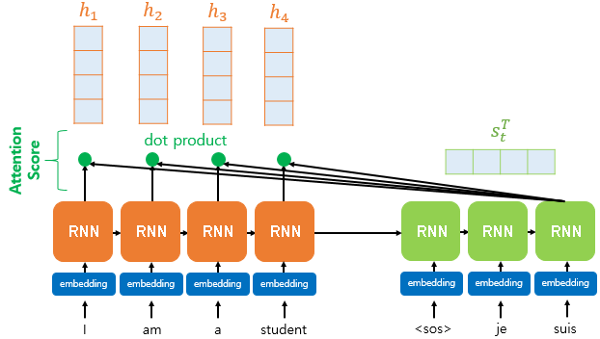
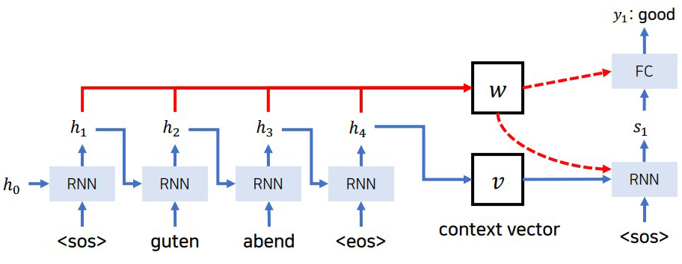
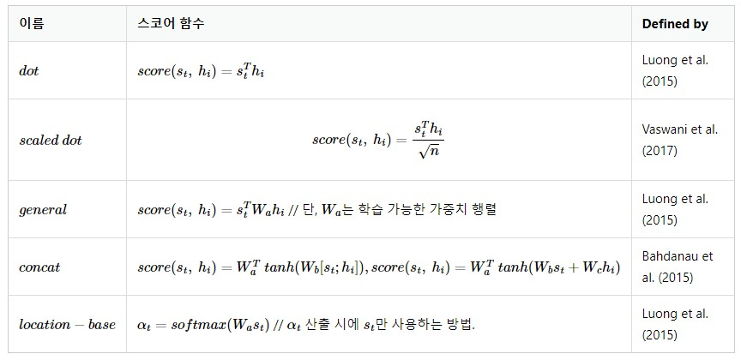
Attention
focus on what to use
12

Slide 13
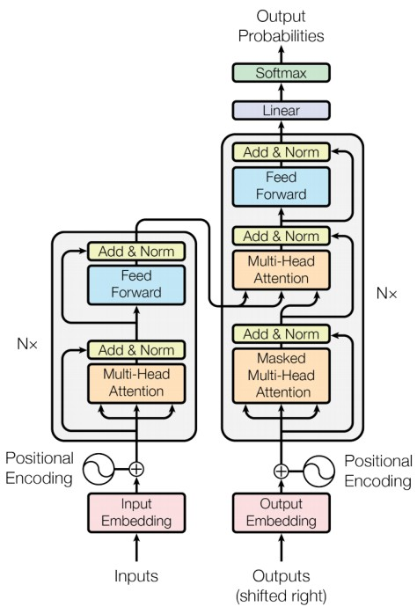
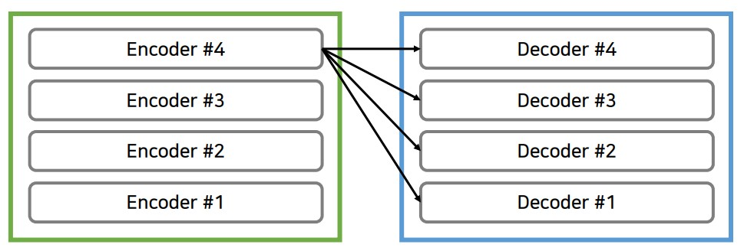
Transformer
attention is all you need
13

Slide 14
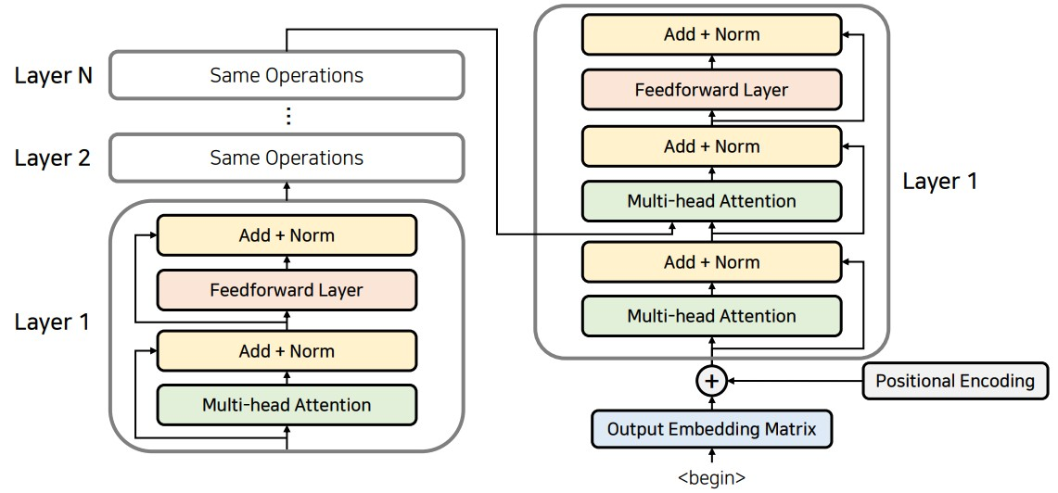
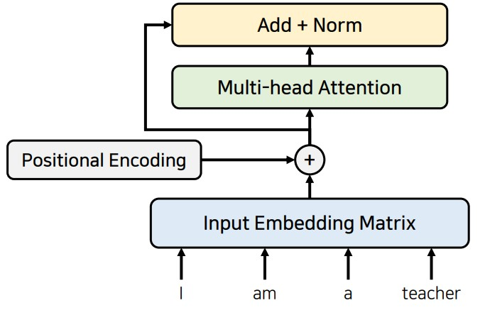
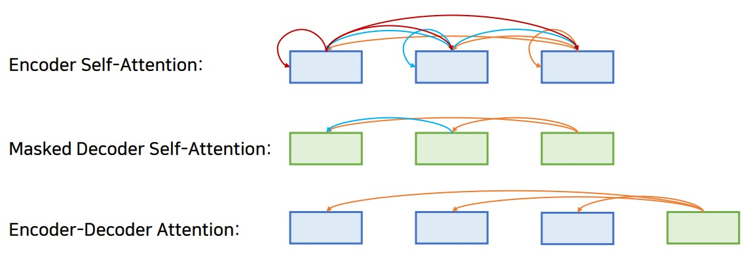
Transformer
attention is all you need
Residual learning
14

Slide 15
GPT
generative pre-trained transformer
GPT: pre-training without labeling, then fine-tuning
GPT2: zero-shot
GPT3: change of structure, few-shot, lots of variable
GPT4, InstructGPT, ChatGPT
15

Slide 16
Reference
Tokenization https://smilegate.ai/2022/05/31/korean-tokenizer/
Embedding https://wikidocs.net/24996
MLP https://m.blog.naver.com/samsjang/221030487369 https://deepestdocs.readthedocs.io/en/latest/004_deep_learning_part_2/0040/
RNN https://wikidocs.net/22886 https://dreamgonfly.github.io/blog/understanding-rnn/
Seq2Seq https://wikidocs.net/24996
Attention https://wikidocs.net/22893
Transformer https://github.com/ndb796/Deep-Learning-Paper-Review-and-Practice/blob/master/lecture_notes/Transformer.pdf https://hyen4110.tistory.com/40
GPT https://velog.io/@jus6886/%EB%85%BC%EB%AC%B8%EB%A6%AC%EB%B7%B0-GPT1-GPT2-GPT3-%EC%B0%A8%EC%9D%B4%EC%99%80-%ED%95%9C%EA%B3%84 https://velog.io/@sjinu/Few-Shot-Learning
16

Slide 17
Q&A

